Slide 1



Auth Integration - Secure Access for AI Dashboards
Presented by:
Dr Grace U. Nneji
Dr Happy N. Monday

Slide 2


Learning Goals for Today
Define essential authentication and authorization terms (identity, session, RLS, JWT, CSRF, refresh token).
Configure Supabase email/password authentication for a new project.
Implement Register, Login, and Logout flows in Streamlit.
Persist user information securely with st.session_state .
Protect pages and API calls via route guard patterns.
Log predictions by user to the predictions table.
Troubleshoot common auth errors and security pitfalls.
AI Summer School

Slide 3
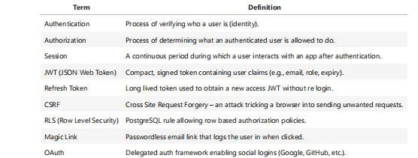
Key Vocabulary & Definitions

Slide 4
Why Authentication Matters in Energy Dashboards
Personalized Analytics – Users see only their building’s data.
Regulatory Compliance – Energy data often contains PII.
Audit Trails – Identify who triggered predictions.
Usage Based Billing – Secure access for premium services.

Slide 5

Supabase Auth Architecture at a Glance
Upon sign in, Supabase issues an access JWT + refresh token.
Calls to supabase.auth automatically include JWT in headers.
PostgreSQL RLS can extract user info from JWT via auth.jwt() or auth.uid()

Slide 6
Enabling Email/Password Auth
1. Supabase Dashboard → Auth → Providers.
2. Enable Email provider.
3. Set password rules and confirmation options.
Tip – For dev/testing, disable email confirmation; for production, keep it ON to reduce spam sign ups

Slide 7
Storing Secrets in .env
SUPABASE_URL=https://<project>.supabase.co
SUPABASE_ANON_KEY=<anon-key>
SUPABASE_SERVICE_ROLE=<service-key>
Anon key: has limited DB rights defined by RLS.
Service role key: bypasses RLS – never ship to browsers

Slide 8
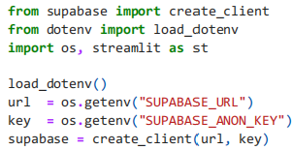
Implementing register / Login in Streamlit
Install SDK & dotenv:
pip install supabase python-dotenv
Initialise Client

Slide 9
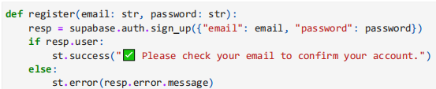
Register Flow

Slide 10
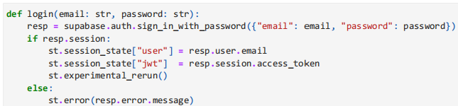
Login Flow

Slide 11
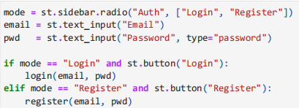
UI Components

Slide 12

Session State & Route Protection
st.stop() halts further script execution.
After login, rerun populates st.session_state["user"], unlocking rest of page

Slide 13
Storing Extra Metadata

Slide 14

Logout Logic

Slide 15
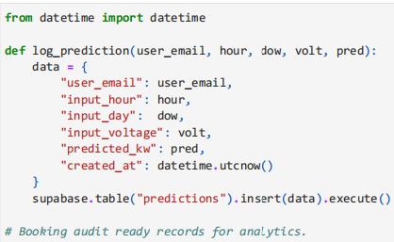
Logging Predictions by User

Slide 16

Thanks for Listening

